Slide 1
Software usage tutorial E.S.tension (email search chrome extension)
CS 410 Fall 2022 Course Project
Team members:
Yueming Pang
Yuling Gao
Schillaci Mcinnis
University of Illinois Urbana-Champaign

Slide 2
About the application
The E.S.tension is a Google Chrome extension that can parse websites and extract email addresses from them. User can navigate to any website, and just one click the “Search” button on the extension popup to find all email addresses on the current website.
User also has the option to save the search results into database. If user provides a query word, the extension can rank all email addresses in the database according to their relevance to the query

Slide 3
Install the software
open terminal and direct to the directory where you want to download the extension. Use the following command to download from the GitHub:
This tutorial was performed in the Windows operating system.

Slide 4
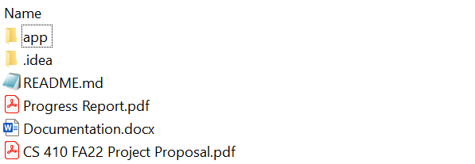
Install the software
Unzipped the file and find the “app” folder.

Slide 5
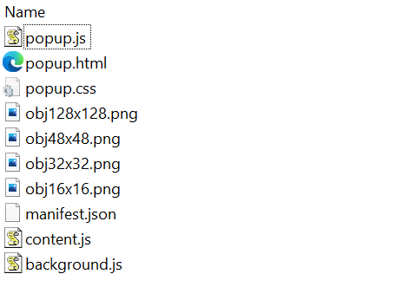
Install the software
In the “app” folder, you will find the following files:

Slide 6
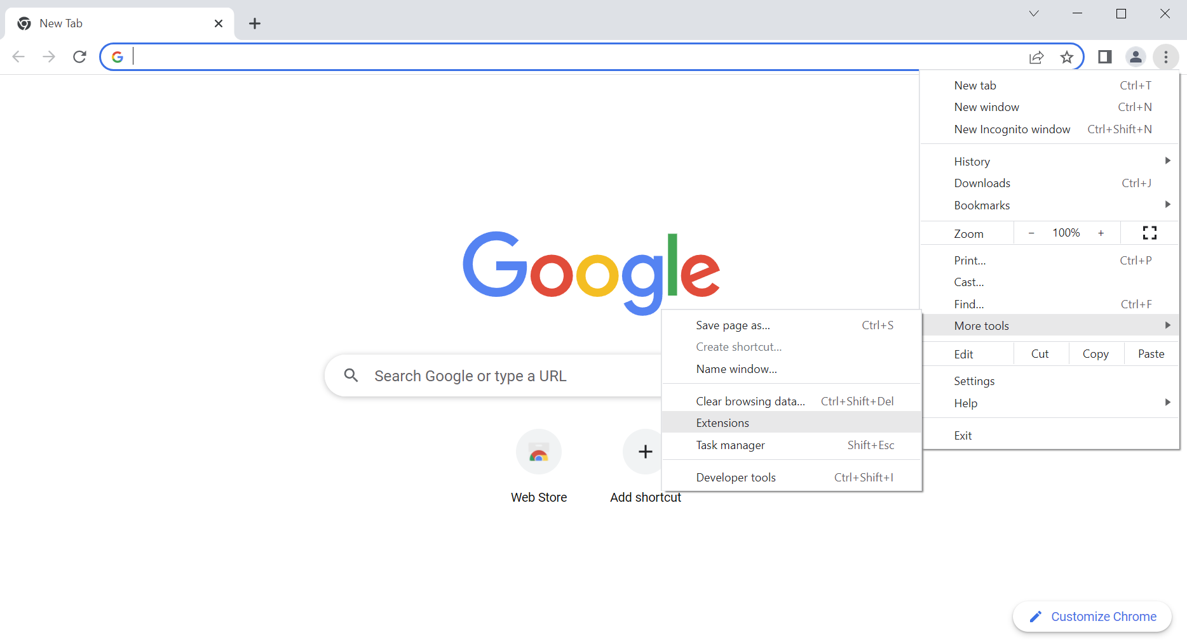
Install the software
Now open your Google Chrome and direct to the extension page:

Slide 7
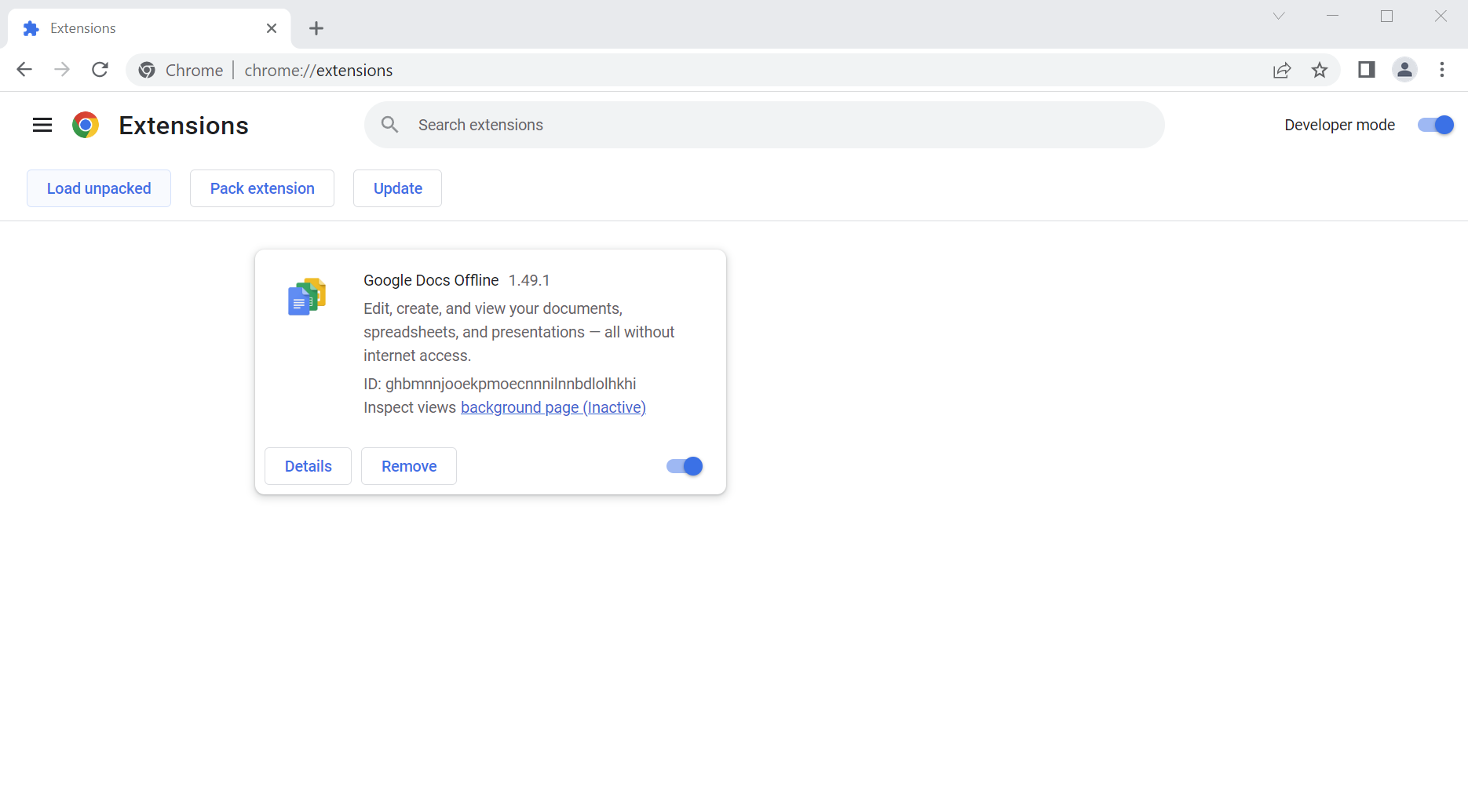
Install the software
In the extension page, enable Developer mode and Load unpacked:

Slide 8
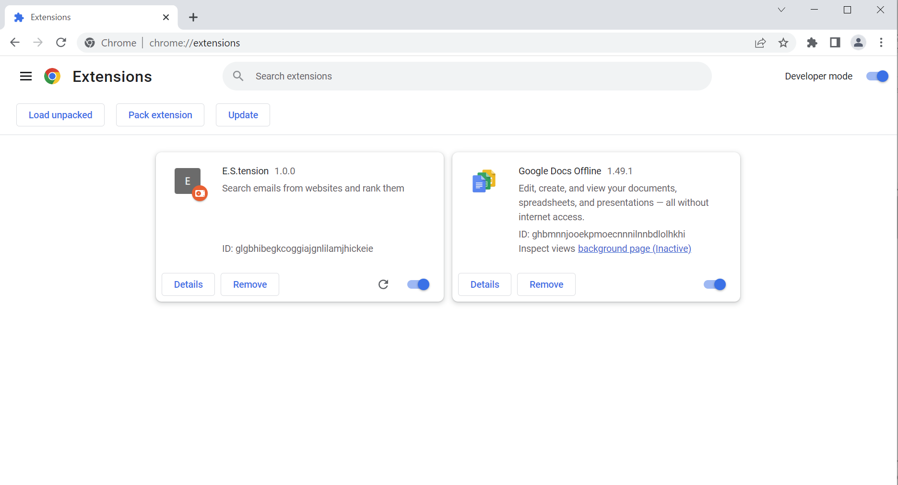
Install the software
Select the “app” folder to unpack and you will see the following:

Slide 9
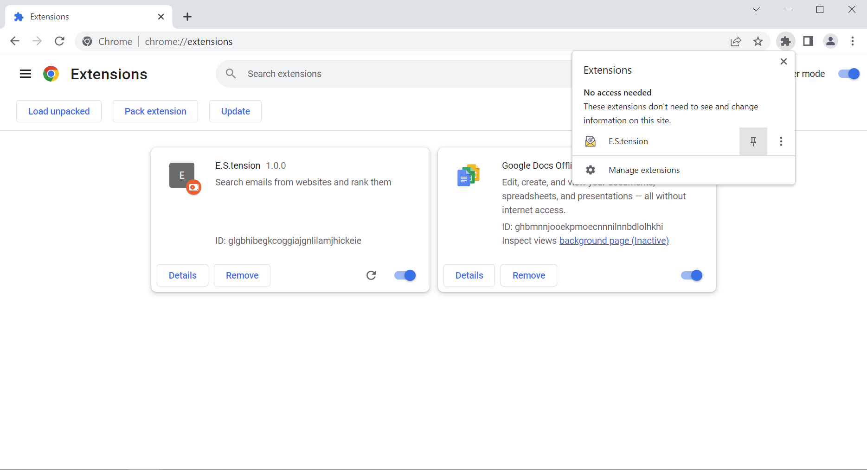
Install the software
Now you can pin the extension to your Google Chrome browser.
You can also remove it by click the Remove button:

Slide 10
How to use the software

Slide 11
An example of use case

